Slide 1

Data Analysis of the Correlation between Education and Crime Rates in North America
Brett Childress, Christin Whitlock, Isha Iqbal, Assam Javaid

Slide 2
Analysis
Why this topic?
Proposal
Hypothesis
Our original project was to show the correlation of Data Science Bootcamps and employment after a program was done. The problem we had was there was too few or no data sets to show the correlation statistically.
Our new topic was to show the correlation between education/graduation rates VS crime rates and how they fluctuate within their relationship.
Analyzation of Education/Graduation and crime data to correlate the relationship between each other over a period.
Our GOAL is to visually show the relationship between both variables and how they can affect each other.
The quality of education directly affects the rate of crime in society.
Null Hypothesis
The quality of education does not directly affect the rate of crime in society.

Slide 3
Data Exploration & Clean-up
Explored data sets via Kaggle which shows crime and incarcerations in the United States as well as graduation rates
In order to clean the data sets we had to sift through the data to show the states and/or cities we selected to be more concise. Most of the data was already cleaned but we had to filter through to get relevant data to get the information we needed.
Also explored the states spending per capita and crime per capita
Had to normalize the data to show the significance of the data per population such as California having a higher population than almost any another state, the numbers may skew in the data since the population is higher and thus have a higher state budget and more crime.

Slide 4


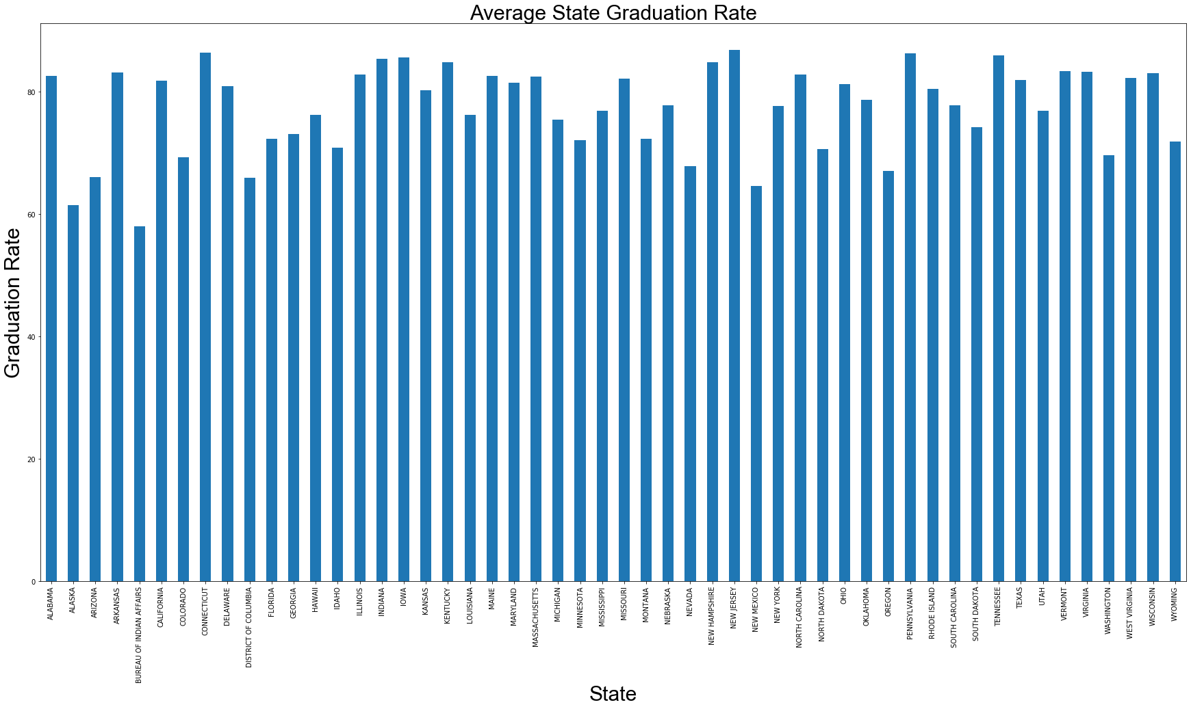




Slide 5
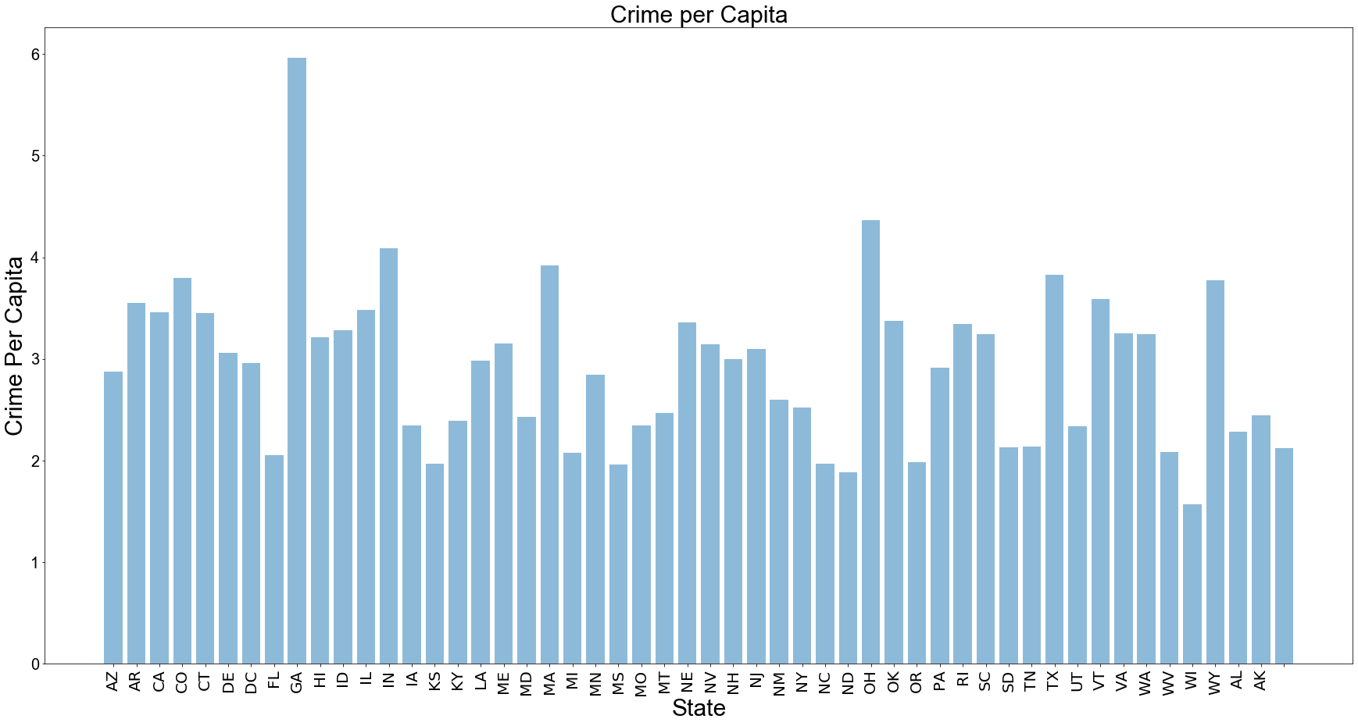

Slide 6
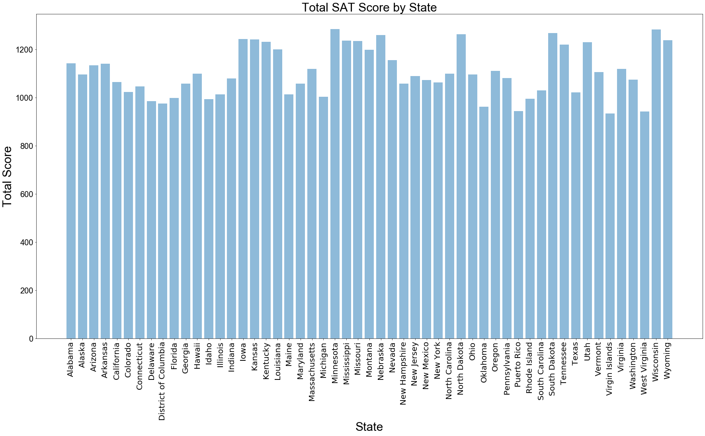

Slide 7
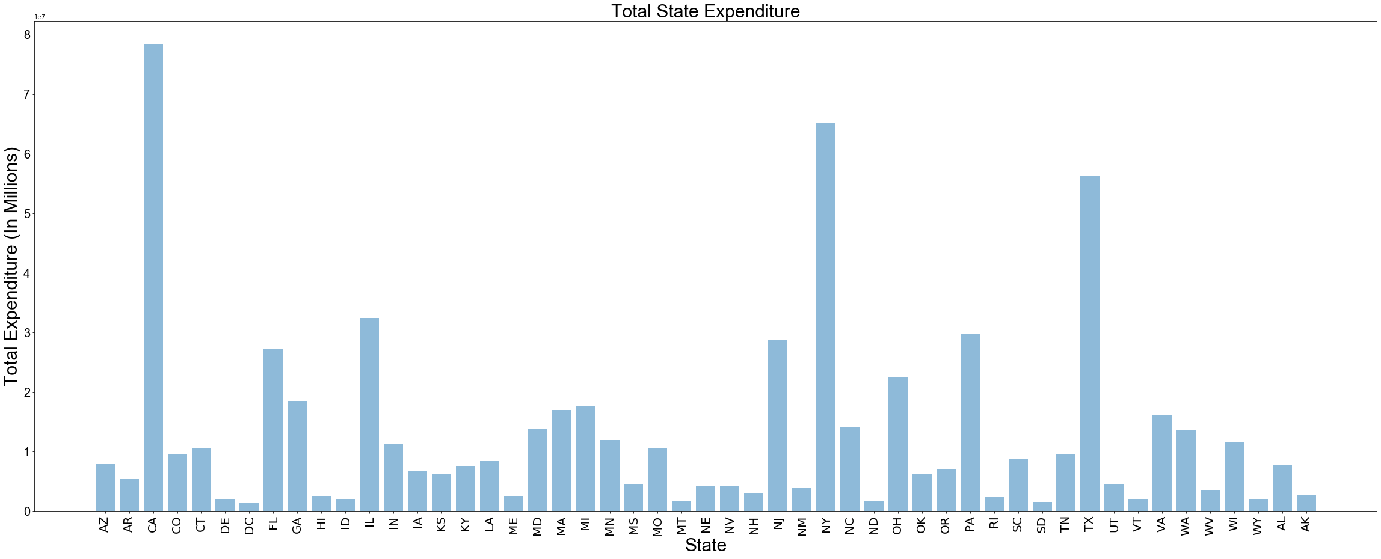

Slide 8
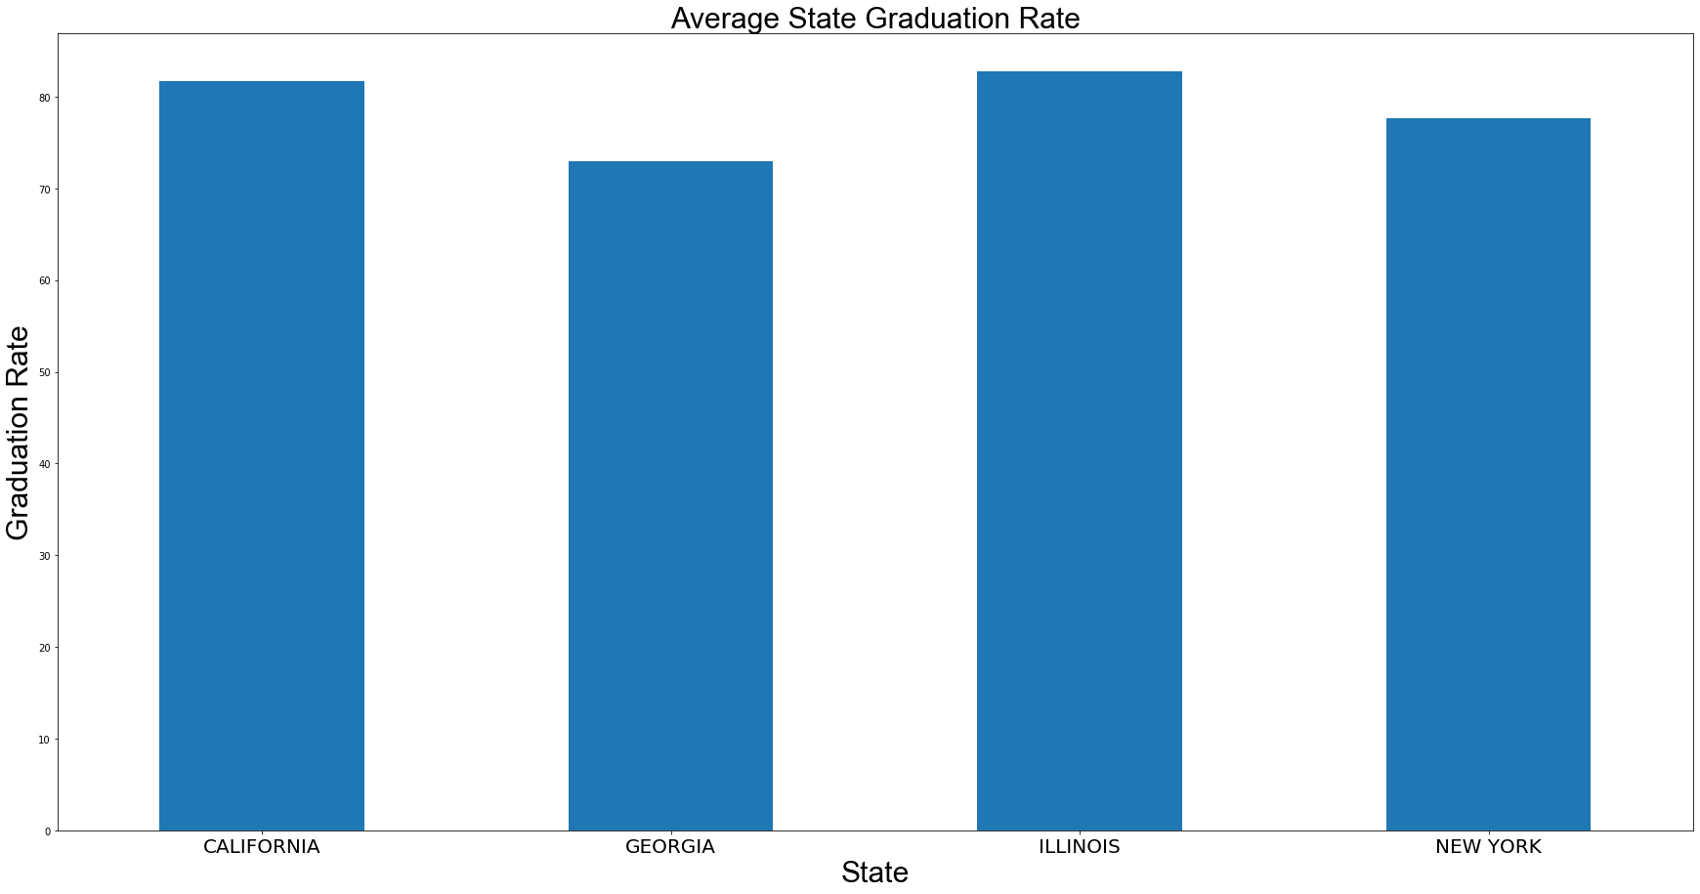
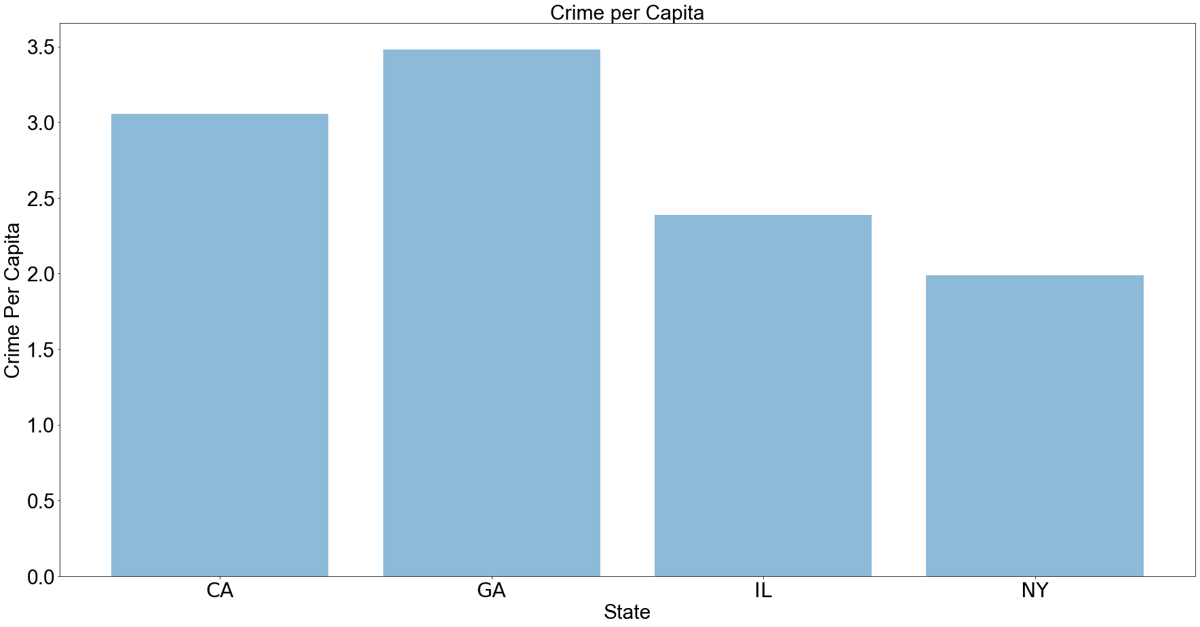
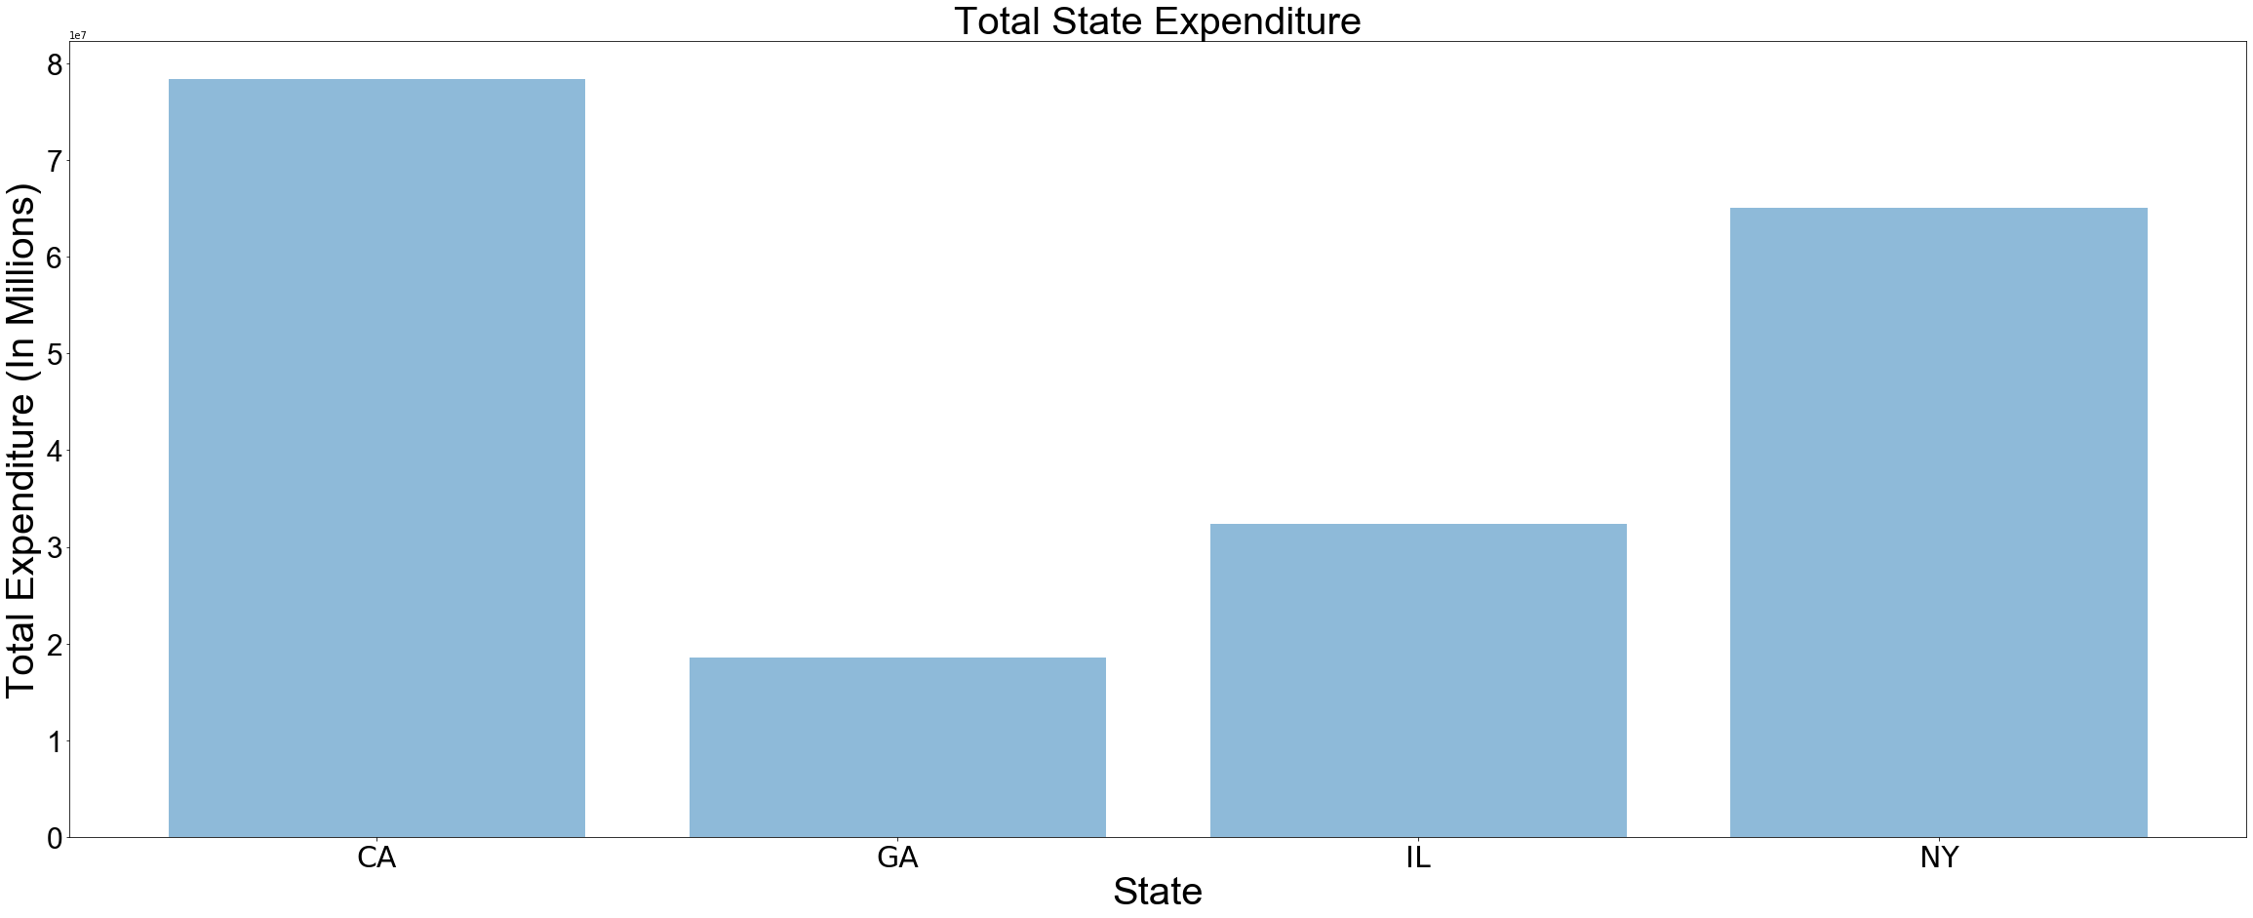
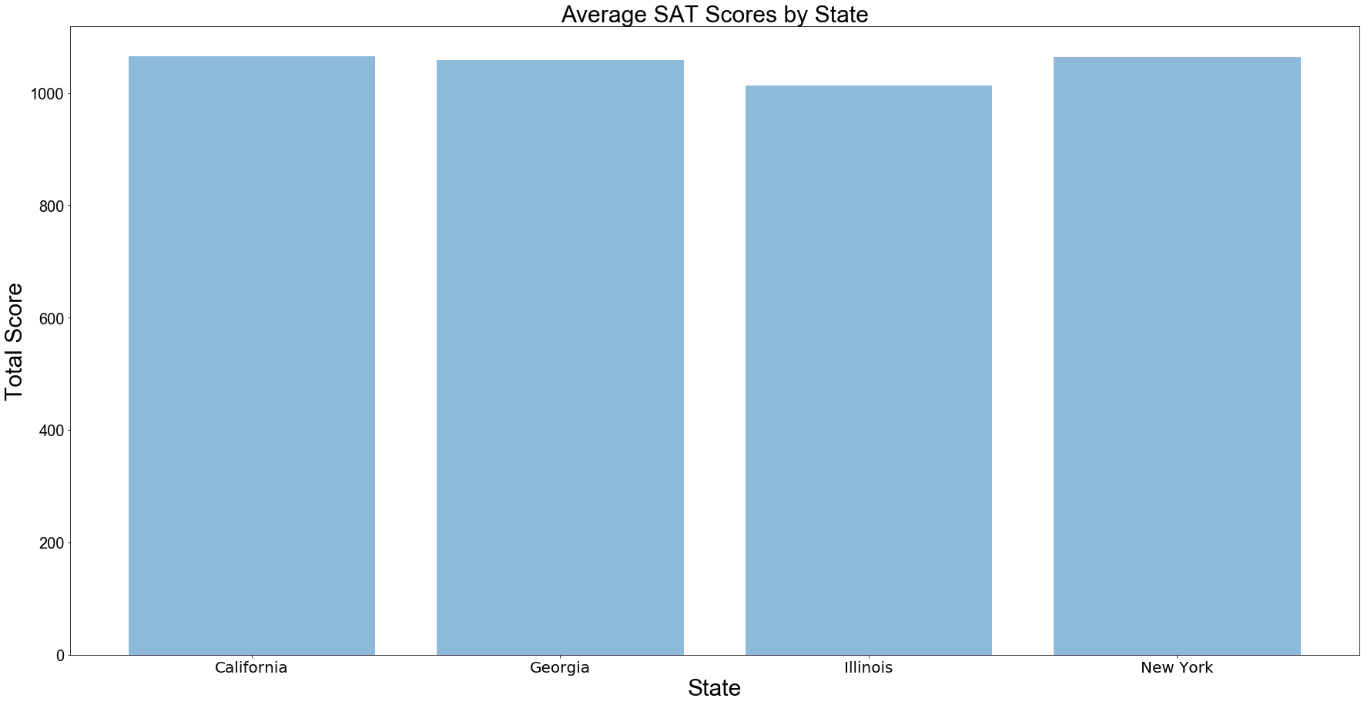

Slide 9
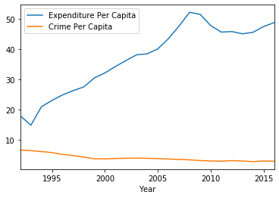
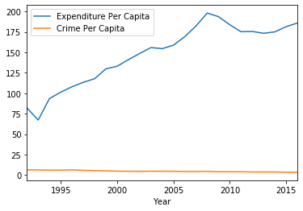
California
Georgia

Slide 10
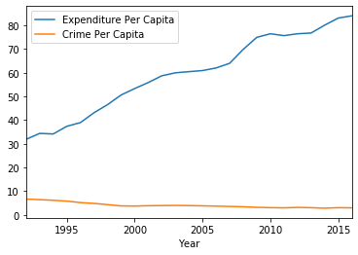
Illinois
New York

Slide 11
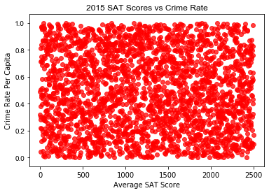

Slide 12
Questions Asked?
What state has the highest crime rate?
Which state has the highest graduation rate?
Do areas with higher educational funding have lower crime rates?
Is there a change in the visualizations that show the more expenditure there is towards education and crime rates decreasing?

Slide 13
Limitations in data
Individual characteristics can affect a person
The type of community a person is raised in may directly affect the costs or benefits of both education and crime
Where the funding is going towards in the educational system. Example: Teachers, Extracurricular activities, Books, Standardized Testing
Parents of children not having gone through higher education
There are numerous variables that could cause someone to commit a crime. Example: Mental State, Self Defense, Romantic Problems

Slide 14
Summarization of Major Findings
The more education/schooling a person goes through shows that a person has more of an understanding of the risks involved committing a crime.
Education is seen as a tool for social improvement, uplifting the poor and changing lives.
Education is generally regarded as a human capital investment that increases work opportunities in the future and thus discourages participation in crime.
Every year of high school completed for an individual decreases the chance of a person committing a crime by eleven percent.

